Slide 1

FOOD SURVEY DURING COVID-19
By
MD AQUIB AZMI

Slide 2
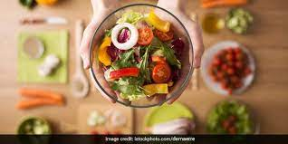
This is the survey related to food behaviour of people of different region, different age group and gender of India during covid-19.

